Slide 1

Adaptive controls
One Size Fits All Steering Controller: Eduardo Rosado, Brandon Foggie

Slide 2
The Motivation
We want to create an adaptive law that makes it easy to attain desired handling qualities in a new car with small amounts of effort.

Slide 3
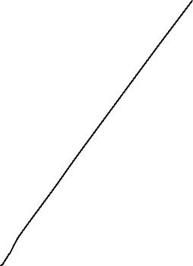
Results
Vehicle 1
Vehicle 2

Slide 4
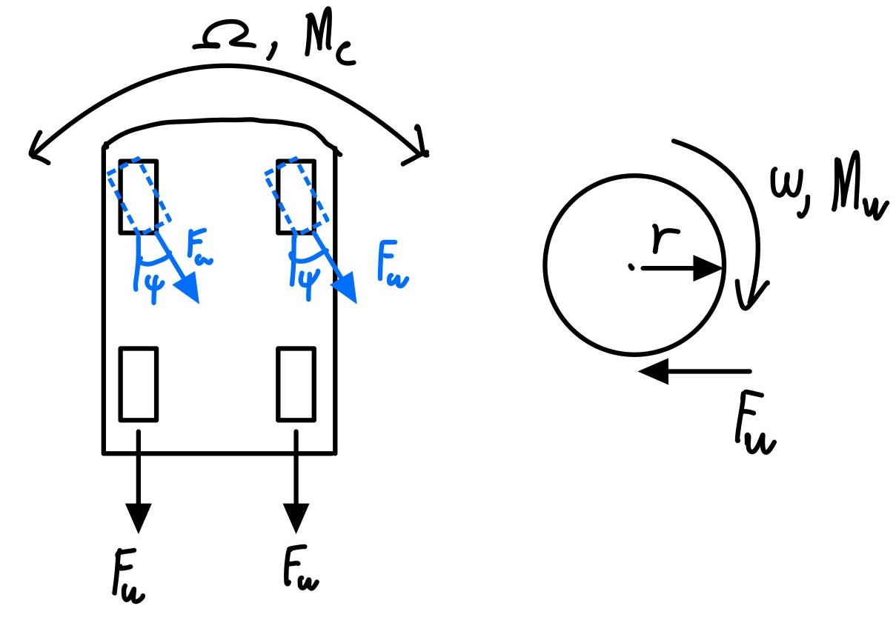

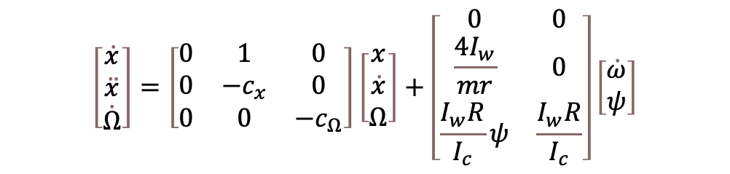
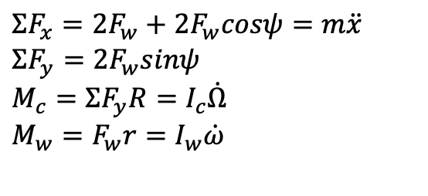
The system
$$ω=wheel angular velocity$$
$$M_{w}= wheel moment$$
$$F_{w}=wheel force$$
$$r=wheel radius$$
$$ψ=wheel rotation angle$$
$$Ω=car angular velocity$$
$ΣF_{x}=2F_{w}+2F_{w}cosψ=m\ddot{x}$
$ΣF_{y}=2F_{w}sinψ$
$M_{c}=ΣF_{y}R=I_{c}\dot{Ω}$
$M_{w}=F_{w}r=I_{w}\dot{ω}$
$$\left[\begin{matrix}\dot{x} \\ \ddot{x} \\ \dot{Ω}\end{matrix}\right]=\left[\begin{matrix}0 & 1 & 0 \\ 0 & −c_{x} & 0 \\ 0 & 0 & −c_{Ω}\end{matrix}\right]\left[\begin{matrix}x \\ \dot{x} \\ Ω\end{matrix}\right]+\left[\begin{matrix}0 & 0 \\ \frac{4I_{w}}{mr} & 0 \\ \frac{I_{w}R}{I_{c}}ψ & \frac{I_{w}R}{I_{c}}\end{matrix}\right]\left[\begin{matrix}\dot{ω} \\ ψ\end{matrix}\right]$$

Slide 5
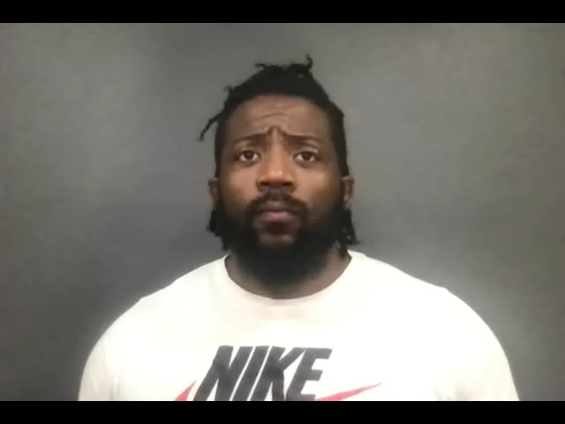
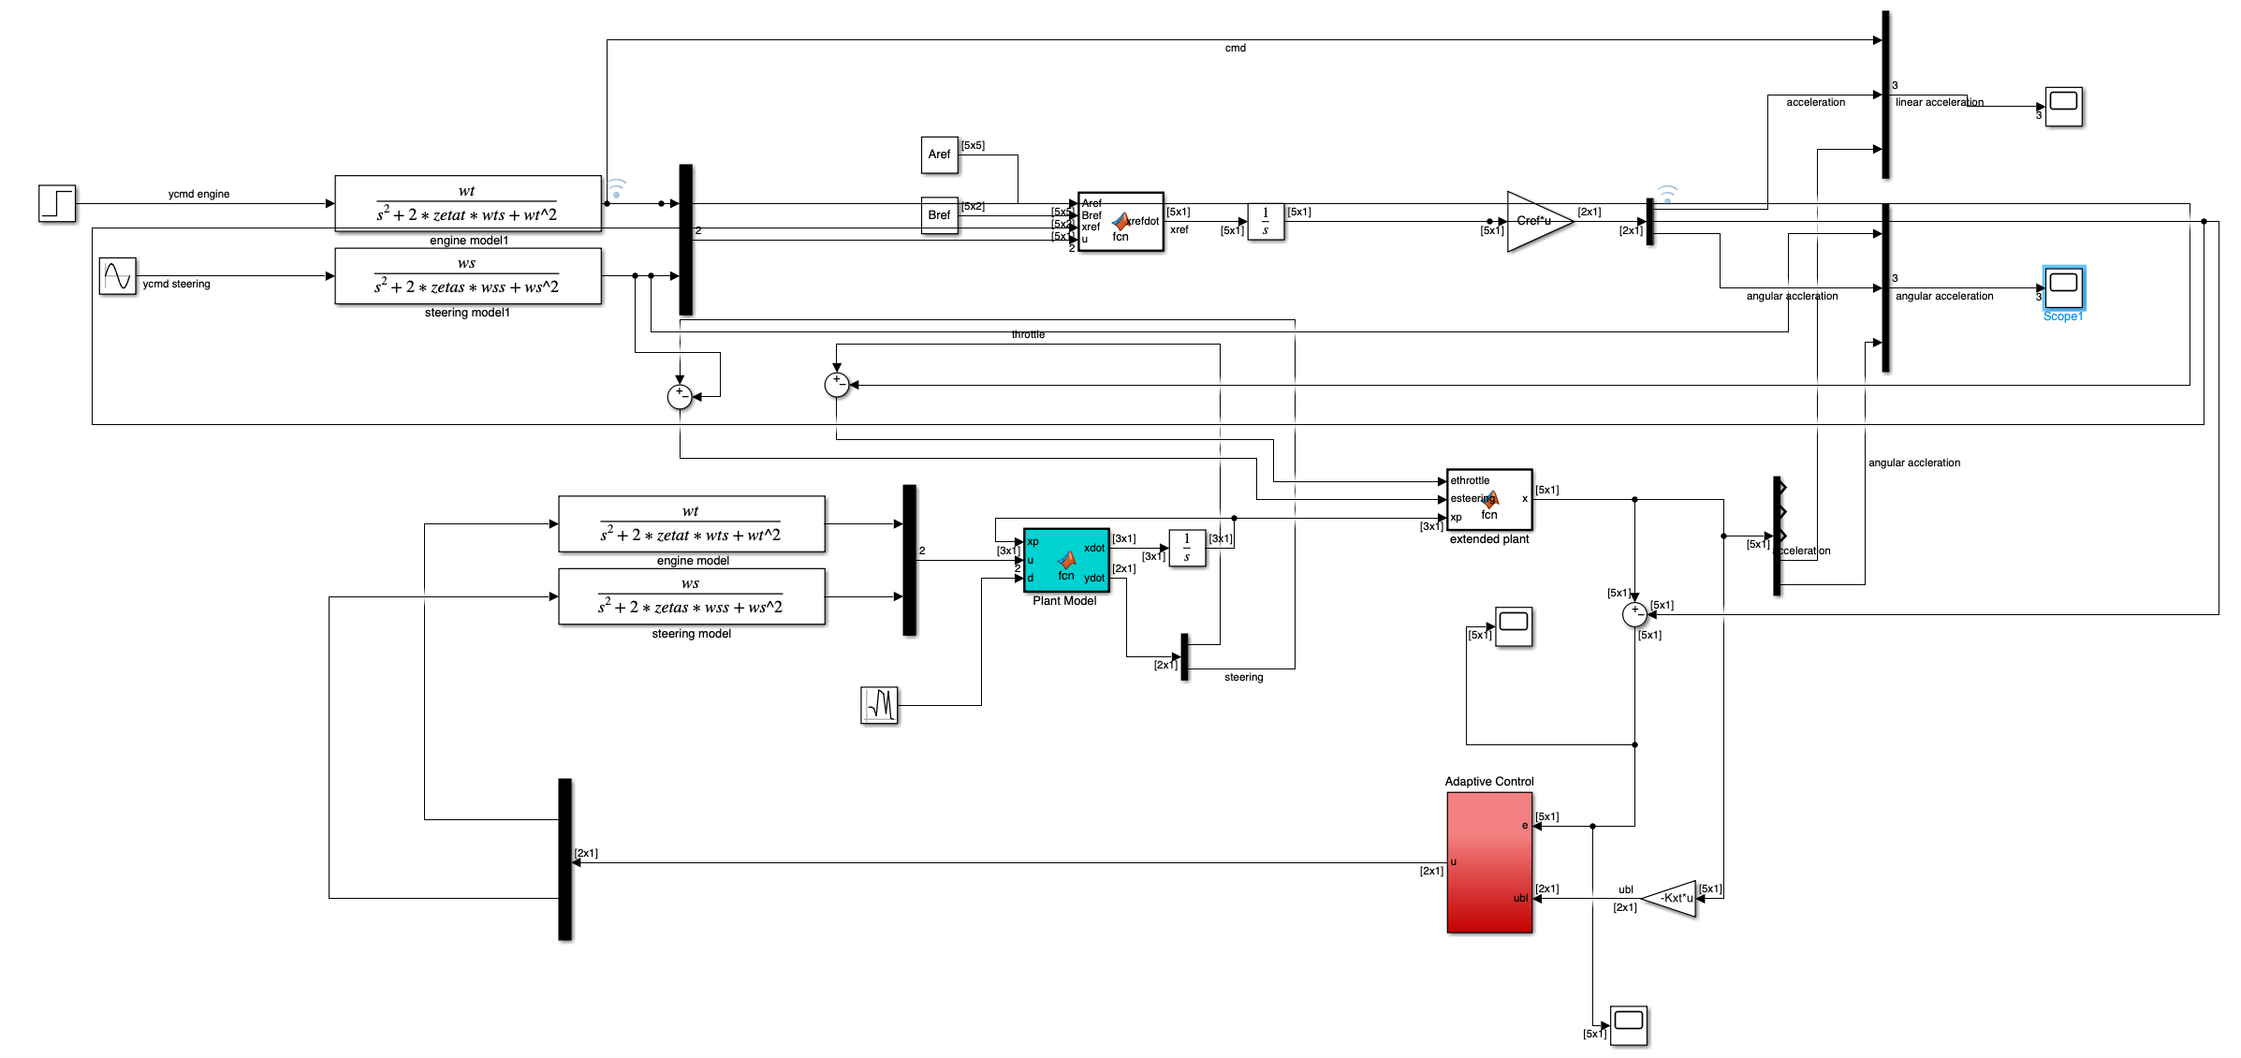
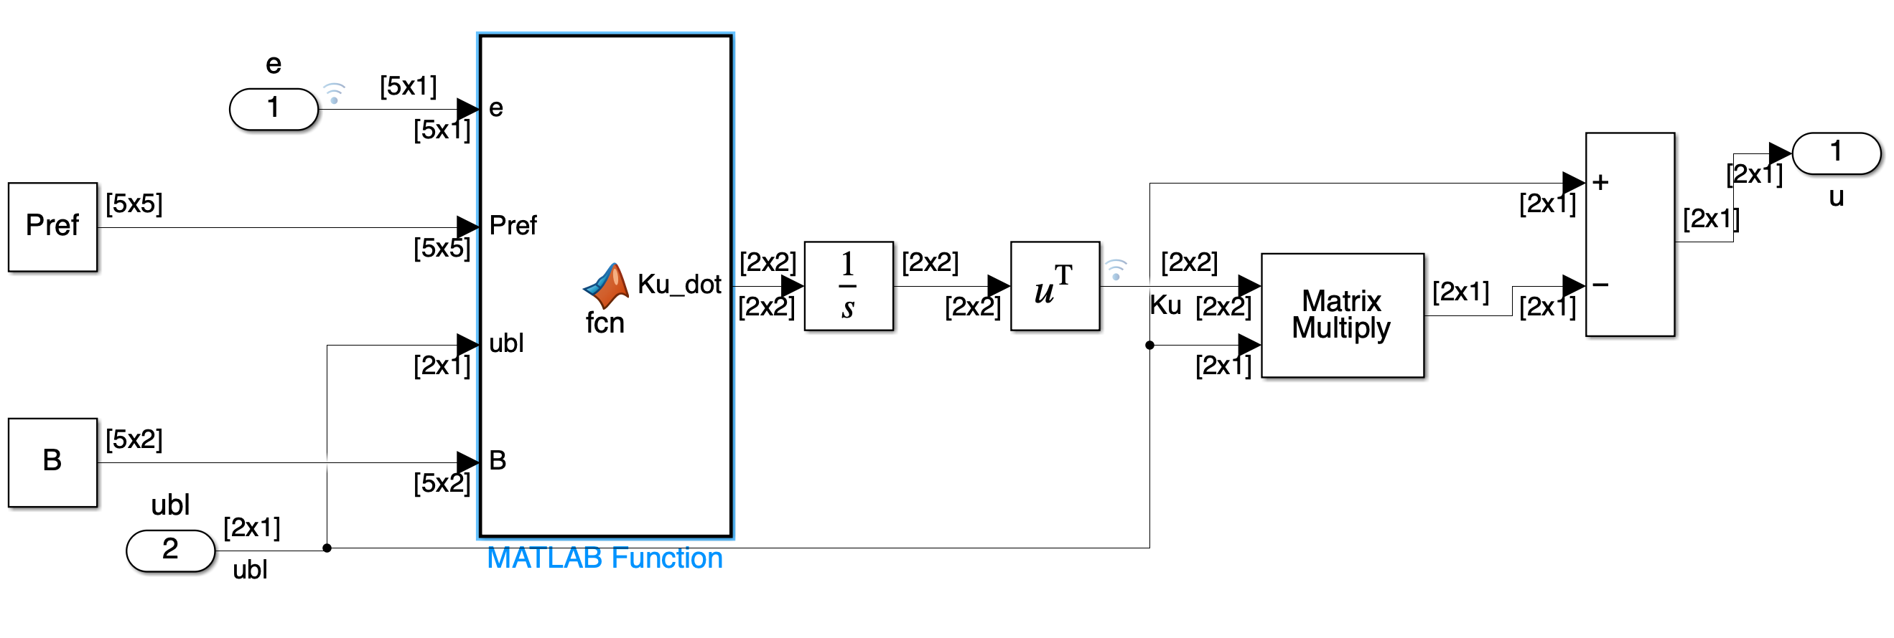
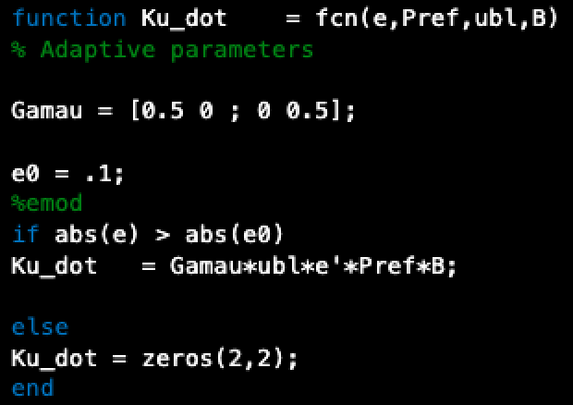
The controller and simulation

Slide 6
conclusion
The results show that a preliminary design of a one size fits all steering controller is effective in achieving desired handling qualities in a vehicle. For now, the implementations were done on a simple model which utilizes approximations for actuators and servos. Next steps include verifying with multiple automobile types and properly tuning for them to see how difficult it is to adapt to different physical properties in the system.

